Slide 1
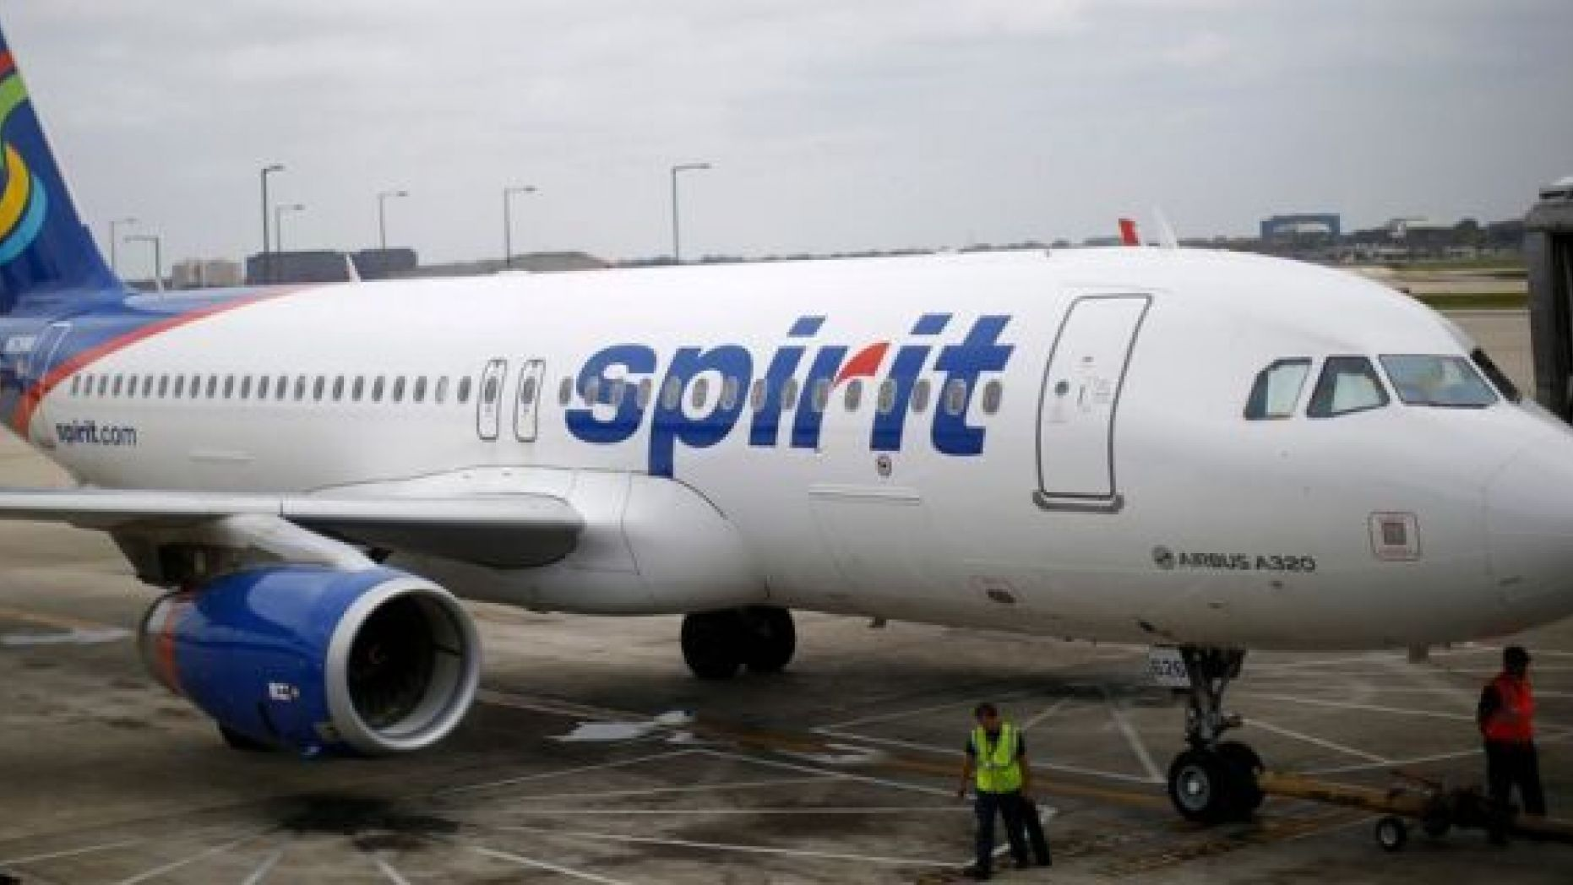
How To Make Bookings
in

Slide 2
If you can afford flying your thing then you have come to the right place. Spirit Airlines have been recorded as the most affordable airline in the aviation industry and which is why it is generally a great option for travelers on a budget.
The facilities and the fares are the two things that make Spirit Airlines a popular option among the passengers.
In order to travel with Spirit Airlines, the passengers need to reserve a seat on the plane and they need to book a flight on the airline. You can really make reservations with Spirit airline online as the process is simple and easy.

Slide 3
For making bookings with Spirit Airlines, all you need to do is to follow the simple steps that are as follows:
Take your phone or a computer and start the flight booking process by visiting the official website of Spirit Airlines. The entire process can be completed online and there is no need to pay a visit in person at the airport for making reservations.
Once you are on the homepage of the Spirit Airlines there you can make reservations by initiating the booking process. First and foremost you need to select the type of the trip that you tend to take. There you get to select from a number of trip types whether you want a round trip or a one-way.
Next, you need to enter the destination that you wish to travel to and the departure city. Next, you need to select the number of passengers that are accompanying you.
After filling all the required information, the next thing you need to do is to hit the ‘Search Flight’ tab.
On the next page, all the results will be displayed and you could select any flight as per your time and budget preference.
After making the flight selecting, the last thing that you need to do in order to complete your reservation is to get done with the payment. For that, you could make use of your credit card or debit card. Once the payment is done, you will receive a confirmation mail and your booking with Spirit Airlines will be complete.
If you face any other problem then you can connect with the Spirit Airlines customer service phone number as they are equipped in delivering the right guidance and help.

Slide 4
To book Spirit Airlines Ticket:-
Contact: +1-802-278-0759
Visit: www.myfaresadda.com

